Slide 1
EMPLOYEE MANAGEMENT SYSTEM

Slide 2
ABSTRACT
Employees are the backbone of any company therefore their management plays a major role in deciding the success of an organization [1]. Employees Management Software makes it easy for the employer to keep track of all records. This software allows the administrator to edit employees, add new employees, transfer/promote/terminate employees. Each employee in the database is associated with a position can be added and edited when need arises. Employees can be transferred between positions easily without having to retype back their information in the database. You can check to see if there are duplicate positions/employees in the database. Most of all, the employer can assign tasks to employees and assess their progress in order to keep track of employee performance.

Slide 3
A flexible and easy to use Employee Management software solution for small and medium sized companies provides modules for personnel information management thereby organization and companies are able to manage the crucial organization asset – people [2]. The combination of these modules into one application assures the perfect platform for re-engineering and aligning Human Resource processes along with the organizational goals. This system brings about an easy way of maintaining the details of employees working in any organization.
It is simple to understand and can be used by anyone who is not even familiar with simple employees system. It is user friendly and just asks the user to follow step by step operations by giving easy to follow options. It is fast and can perform many operations for a company.
The goal of this project is to design and develop an employee management system to fill existing gaps in the electronic management of employees

Slide 4
Hardware Specification
Processor : P 4 700 GHz.
RAM : 256MB RAM
Hard Disk Drive : 40 GB HDD

Slide 5
Software Specification
Operating System : Windows XP/7/8/10
Front End : JAVA
Back End : MY SQL

Slide 6
EXISTING SYSTEM
In this existing system very hard to managing the employees manually. Sometimes it has taken more to search one particular employees. This will take too much time to find one employee.

Slide 7
Disadvantages:
It takes too much time to find employee
Can’t handle employee working hours
We can’t track the employee
Wasting paper based period

Slide 8
PROPOSED SYSTEM
This system will be overcome these kind of issue, which makes to find and employees details at any time. We can track the employee immediately. We can easily find the employee working hours also which may helps to find the employee who are taken leave on that day.

Slide 9
Advantages:
Tracking employees details
Attractive interface
Every one can using this software.
Low cost and high benefit

Slide 10
MODULES
Salary management module
Leave Module
Attendance Module
Login Module

Slide 11
Modules
Manager and User Login
Manager and employee both can login this portal. Every users have own credential. Which make secure to display the details. Manager’s can’t seen others employees details.
Leave Request:
Employee should sending the leave request before taking a leave. The request was accept by administrator. If the administrator does not accepting the leave request employee can’t to take a leave. So manager can find who are all taking a leave on today.

Slide 12
Leave Apply
Manager has seen the requested employees leave request and they decide to accept or reject the leave request. Once they accept or rejected the request then the employee will get notify
Salary Management
Salary management module is used managing the salary details for employees. Admin can manage all the employees salary details. Every month we can generate the payslip by admin.

Slide 13

Data Flow Diagram
Level 0

Slide 14
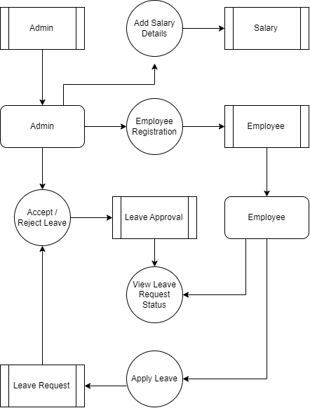
LEVEL 1:

Slide 15
Thank you.....

